Slide 1
GMA Lite – Advanced App Topic
10th May 2023

Slide 2
Advanced App Topics
Fraud Prevention
Remote Configuration Tool
WebViews vs Smart WebViews
Customer Care Portal
Market Engine
PhraseApp

Slide 3
Fraud Prevention

Slide 4
Same device, different email accounts
Install GMAL app, redeem offer, uninstall and reinstall GMAL app
Using rooted devices
Using the Secure Folder option in Samsung devices
Using Parallels software in Android
Changing date/time of user device
Disable screen recording on Production iOS
Disable screen capture and recording in Android

Slide 5
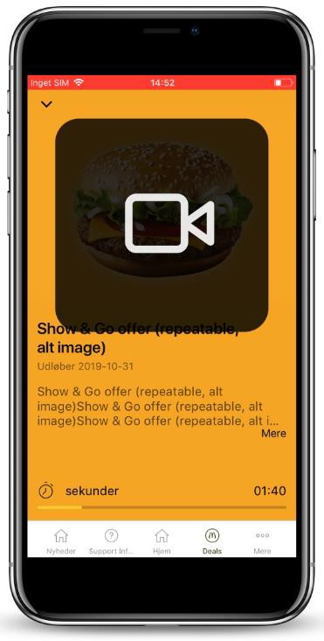
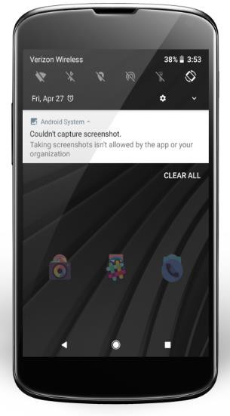
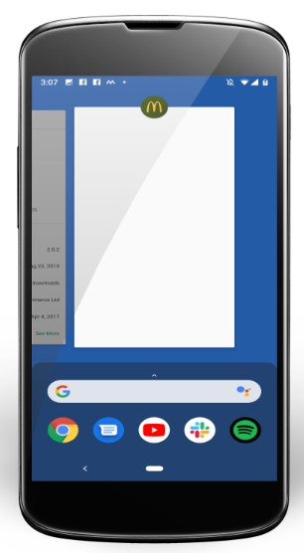

Slide 6
Smart Web View

Slide 7

What is a Smart WebView
Enhanced web view module referred to as the Smart WebView.
Bridge between the native GMAL app and the Web App (web site) embedded in the WebView
Smart WebView functionalities allows:
Authenticate the user from the app
Use native app functionality such as location
Send data to Plexure and activate offers/rewards for specific user
Reference: https://us- confluence.mcd.com/pages/viewpage.action?spaceKey=GL&title=Creating+Content+for+Smart
+WebViews

Slide 8
What can Smart Web View Be Used for?
No approval needed These are existing approved uses of the SWV | Review Needed Inform your DAT (except for Sweepstakes where only local compliance needs to be gained) | Not Allowed to Do These features exist in GMAL / GMA so competing functionality should not be developed to ensure product governance is managed
Simple games without any rewards | 3rd Party Ordering / Delivery Integration | In-Store Mobile Order and Pay
Games which generate a single reward for the customer or which have some controls applied (using Plexure reward activation fraud protections) to regulate the number of rewards generated | Any campaign which would make a lot of calls to the system per single user and/or would encourage a lot of users to interact at a very specific time | Any campaign which calls on the Smart WebView bridge (and any of its plugins) that encourages all users in the market to interact at a very specific time
Customer feedback surveys | Anything that is not clearly in the Green or Red column | Anything which does not comply with McDonald's Information Governance Policy or other Legal, Fiscal, Security or Marketing/Brand policies
Simple webpages with no significant user interaction or data transfer | Games which could generate more than one reward for a user and/or campaigns that don't make use of the reward activation fraud protections on Plexure | Any site designed primarily to extract customer data from GMA Lite in order to store/process it elsewhere
 | Payment Wallets | An alternative to the existing loyalty functionality in GMA Lite
 | Sweepstakes / Random Draws with non-food or cash prizes (Market Legal approval will be needed and a Certified Gaming Agency Partner may be required)

Slide 9
Market Engine

Slide 10
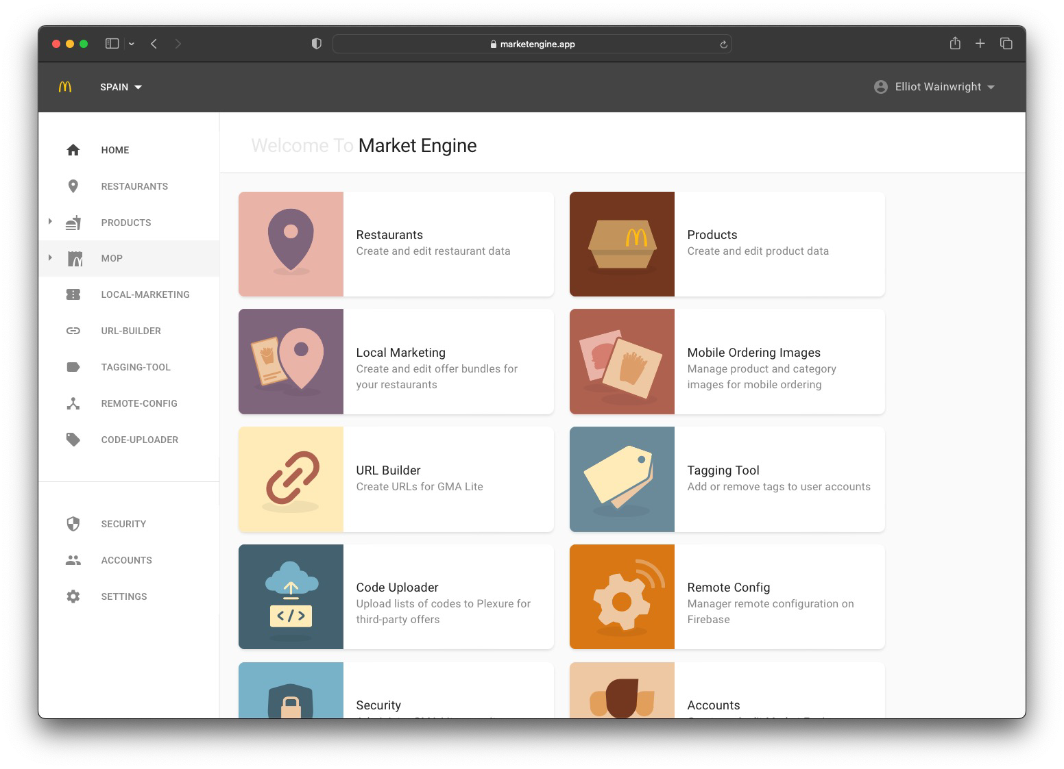
Introduction
We’re introducing an exciting new feature to the Market Engine which should help save everyone a lot of time and allow you to engage with the GMA Lite solution in new ways.
Say hello to Self-Service Remote Configuration!
In this presentation we’ll review the existing remote configuration capability, introduce the new self- service functionality, highlight what it is capable of right now and give you a sneak peak into what is coming next.
We will also review the project timelines and take a quick look at the help & support resources available for the Self-Service Remote Configuration.
But before we get to that, lets take a look at how the Market Engine is evolving…

Slide 11
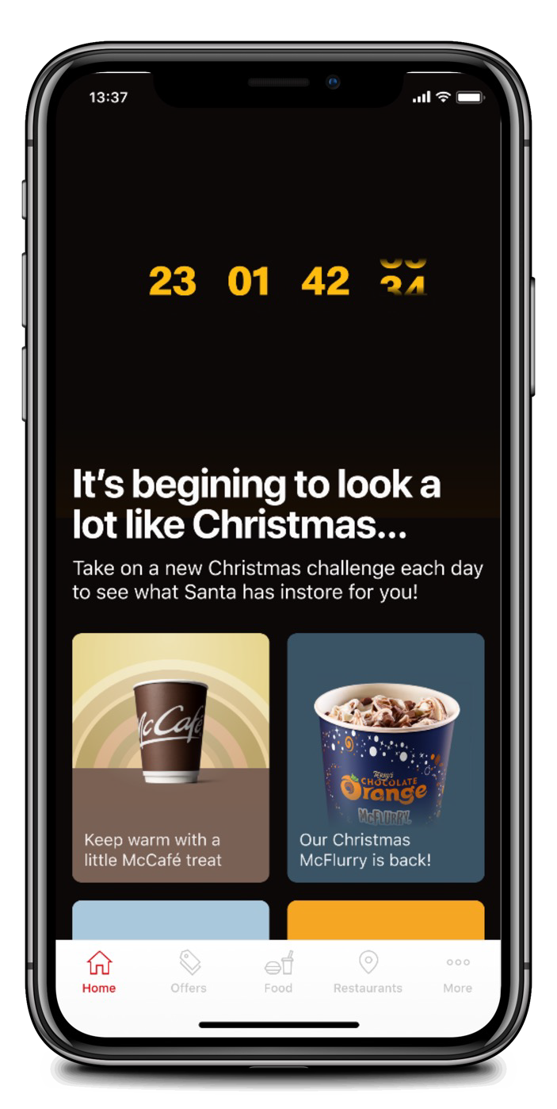
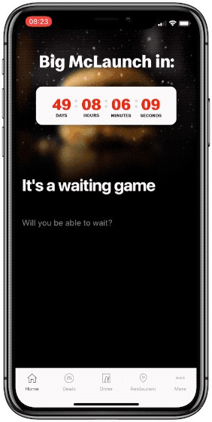
Available Configurations – Home – Countdown Timer
You can configure the ‘Hero’ Banner Ad to show a countdown timer.
This countdown timer can be configured so that days, hours, minutes and seconds are visible or hidden and the text colour of the timer is also configurable.
You still need to add a 'News Appearance > Show Countdown Timer' content tag to the Banner Ad that you create in Plexure.
More details on how to configure this available here on Confluence.

Slide 12
Available Configurations – Home – Countdown Timer
Configuration Key | Configuration Type | Format | Default Value | Description
news_countdown_timestam p | String (Text Field) | Timestamp | N/A | Countdown Timer - Timestamp (e.g: 2023-12-30T09:00:00Z)
news_countdown_fontColor | String (Text Field) | Colour / Hex | Red | Countdown Timer - Font Color (e.g: 'Red' or 'FFFFFF')
news_countdown_showDays | Boolean (Toggle Switch) | True / False | False | Countdown Timer - Show Days
news_countdown_showHour s | Boolean (Toggle Switch) | True / False | False | Countdown Timer - Show Hours
news_countdown_showMinu tes | Boolean (Toggle Switch) | True / False | False | Countdown Timer - Show Minutes
news_countdown_showSeco nds | Boolean (Toggle Switch) | True / False | False | Countdown Timer - Show Seconds

Slide 13
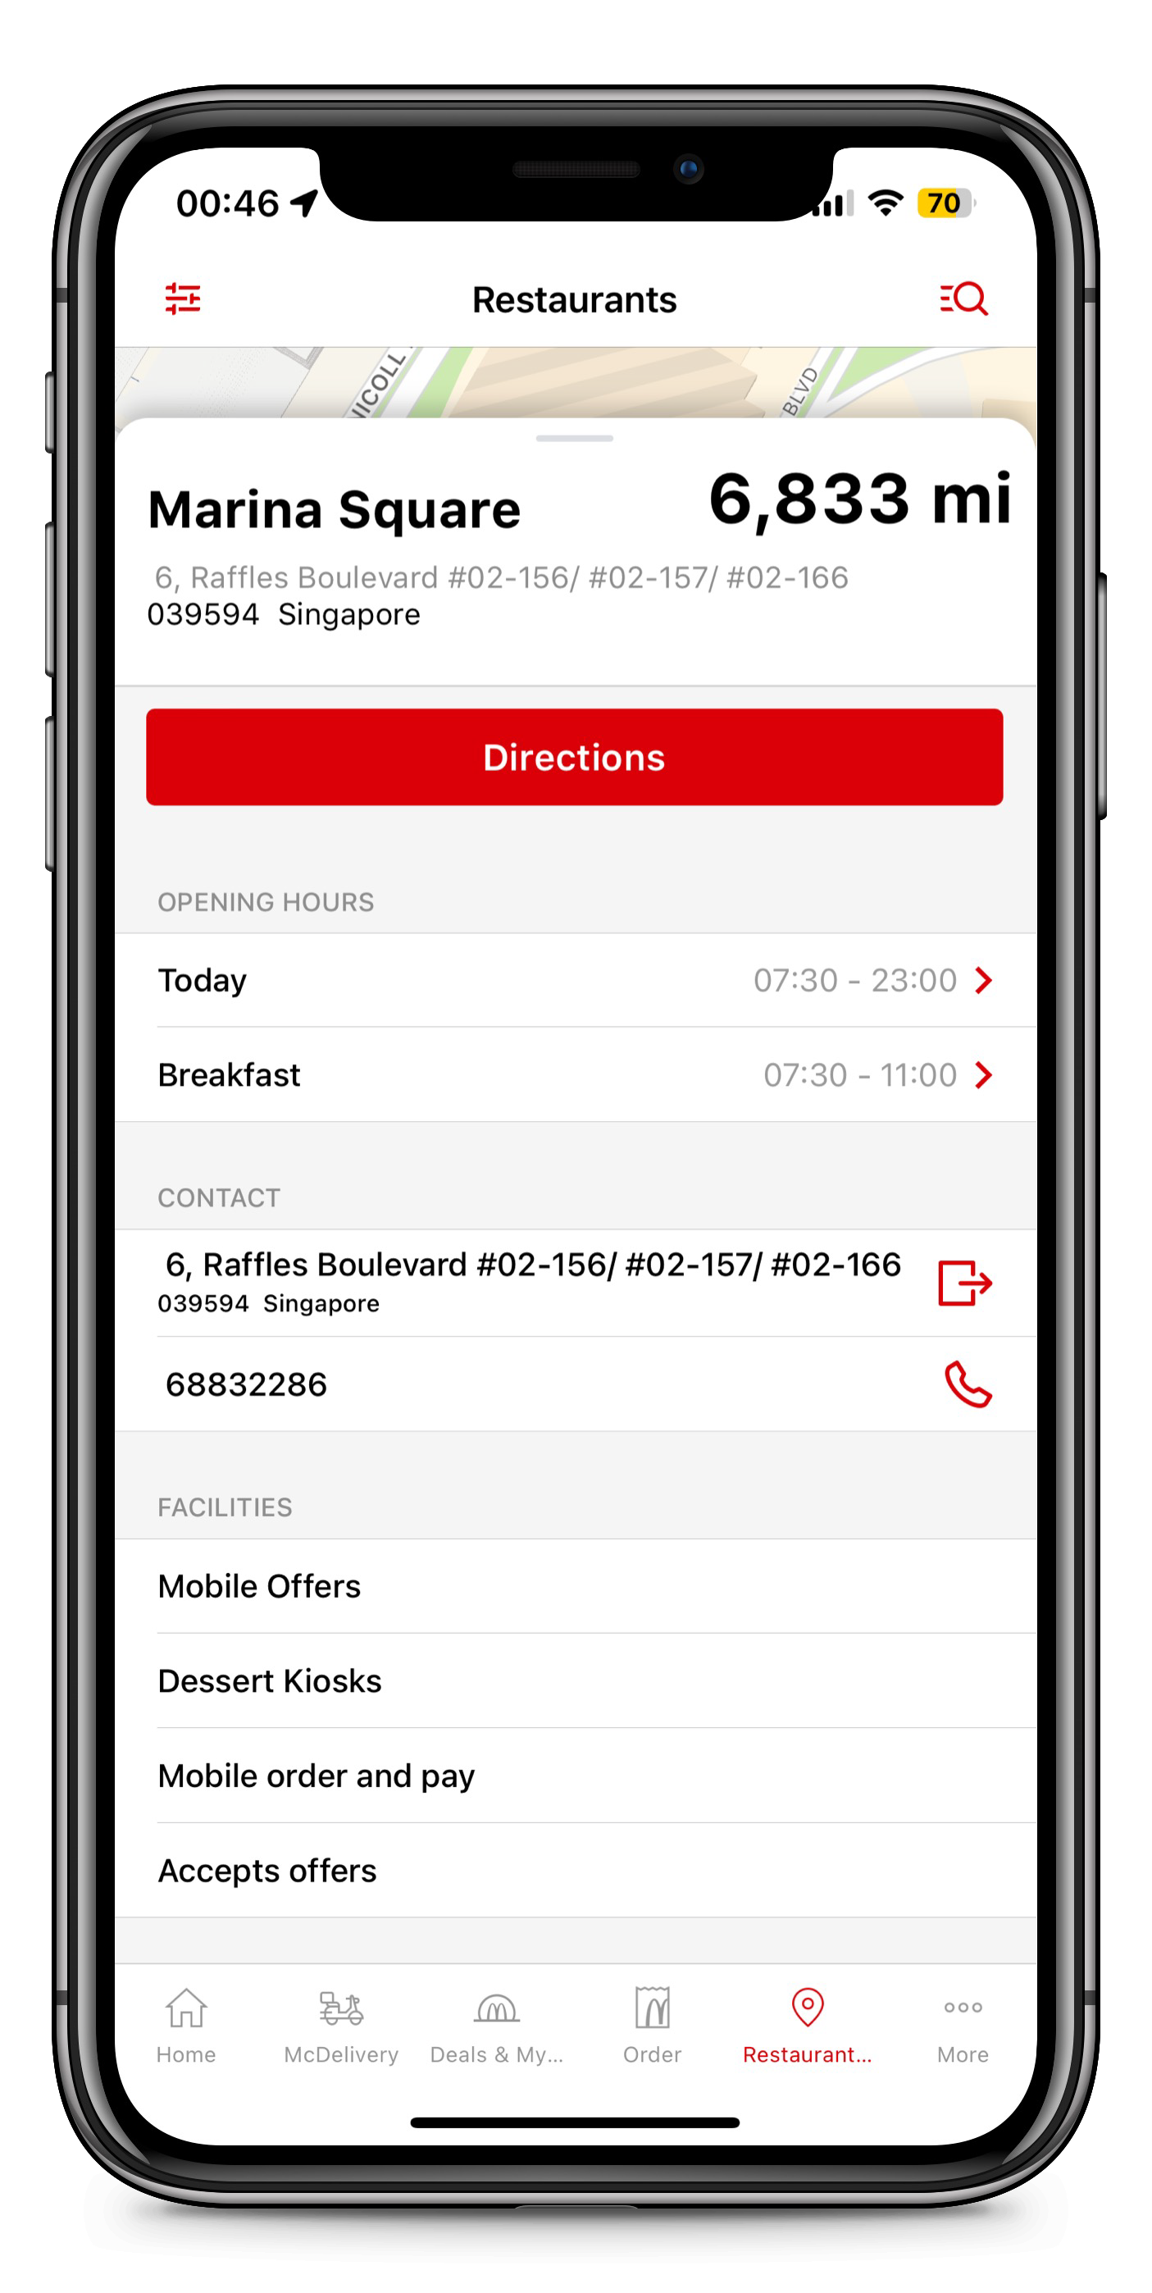
Available Configurations – Restaurant
restaurant_hideDirectionButton
restaurant_hideOpenHours
restaurant_hideContact
restaurant_hideFacilities

Slide 14
Available Configurations – Restaurant
Configuration Key | Configuration Type | Format | Default Value | Description
restaurant_hideDirectionButt on | Boolean (Toggle Switch) | True / False | False | Hide the 'Get Directions' button on the restaurant details view
restaurant_hideContact | Boolean (Toggle Switch) | True / False | False | Hide the ‘Contact Details’ section on the restaurant details view
restaurant_hideFacilities | Boolean (Toggle Switch) | True / False | False | Hide the ‘Facilities’ section on the restaurant details view
restaurant_hideOpenHours | Boolean (Toggle Switch) | True / False | False | Hide the ‘Opening Hours’ section on the restaurant details view
© McDonald’s

Slide 15
PhraseApp

Slide 16
PhraseApp
Remotely updatable String:
All string that are translated in the PhraseApp will affect the application remotely. This means without creating a new application release, the app will get the latest translation from PhraseApp every midnight CET time. So if you translate something in the PhraseApp, you can expect that the translation is in the application next day.

Slide 17
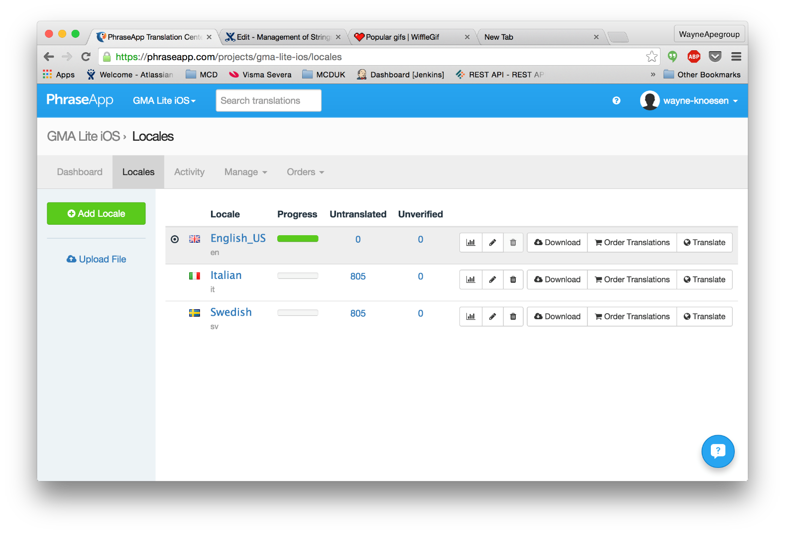
PhraseApp
How to Translate String:
1) Login to Phrase app and select the project you want to work with.
2) You will see the total of untranslated strings in this view. 805 untranslated strings in this case

Slide 18
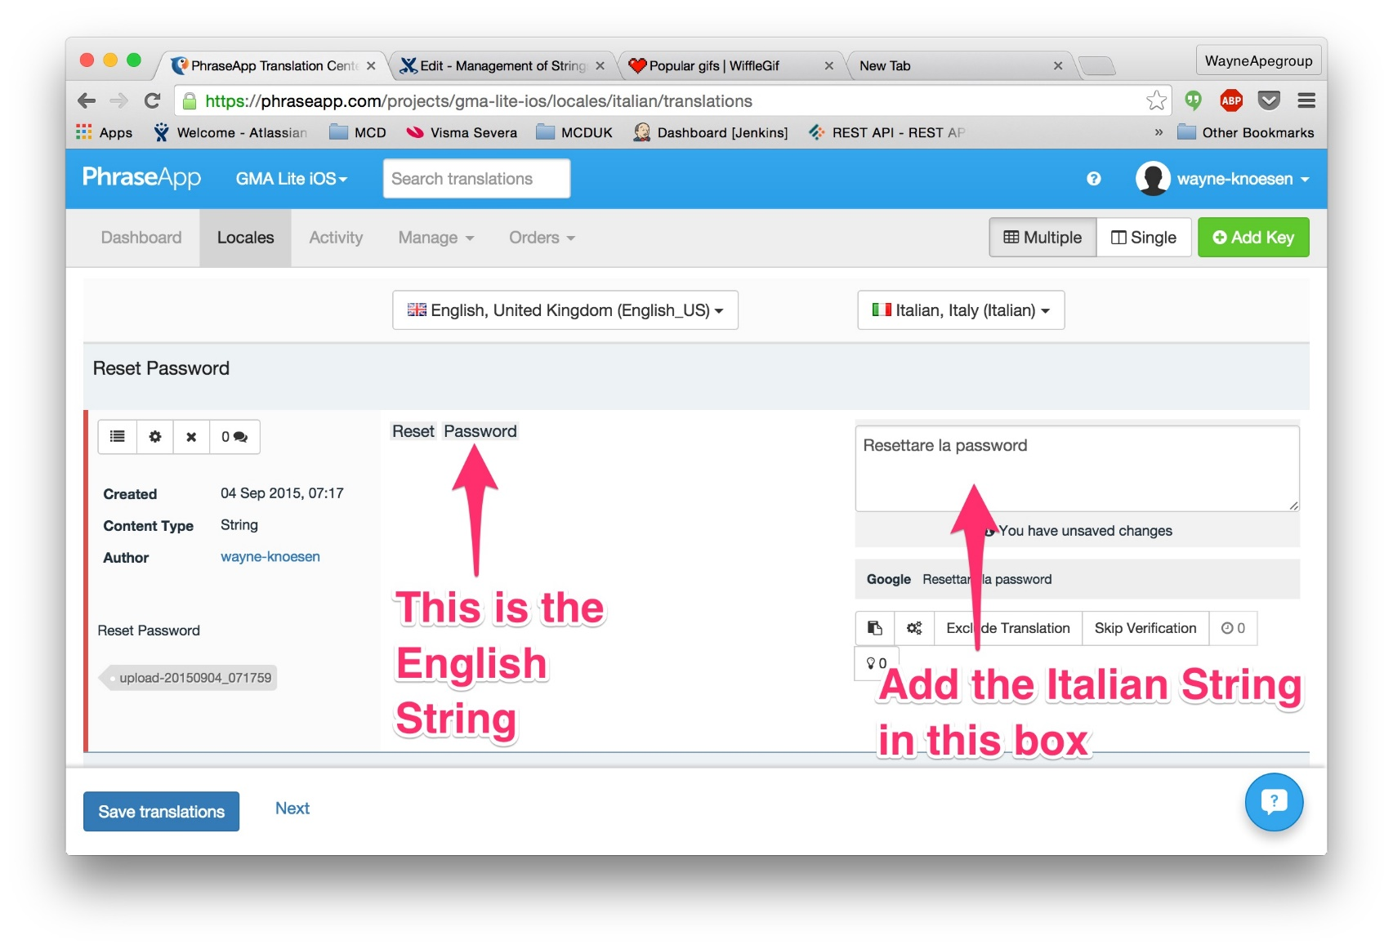
PhraseApp
3) Select Your Language.
4) You will see the English string on your left side of the screen

Slide 19
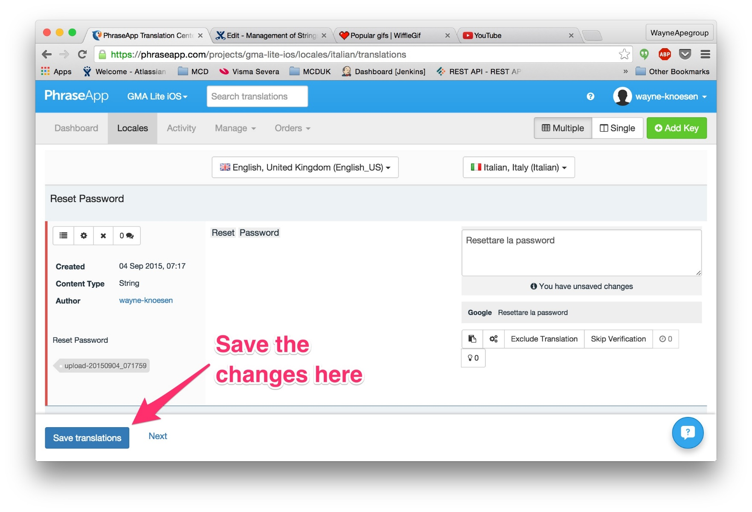
PhraseApp
5) Add the translation to the string on the right hand side.
6) Press save to save your changes

Slide 20
Feedback, questions?

